Slide 1
Lab 1
Cindy J. Pang
Lab 1B, MWF 12:00-12:50pm
Week 1 – August 8, 2024

Slide 2
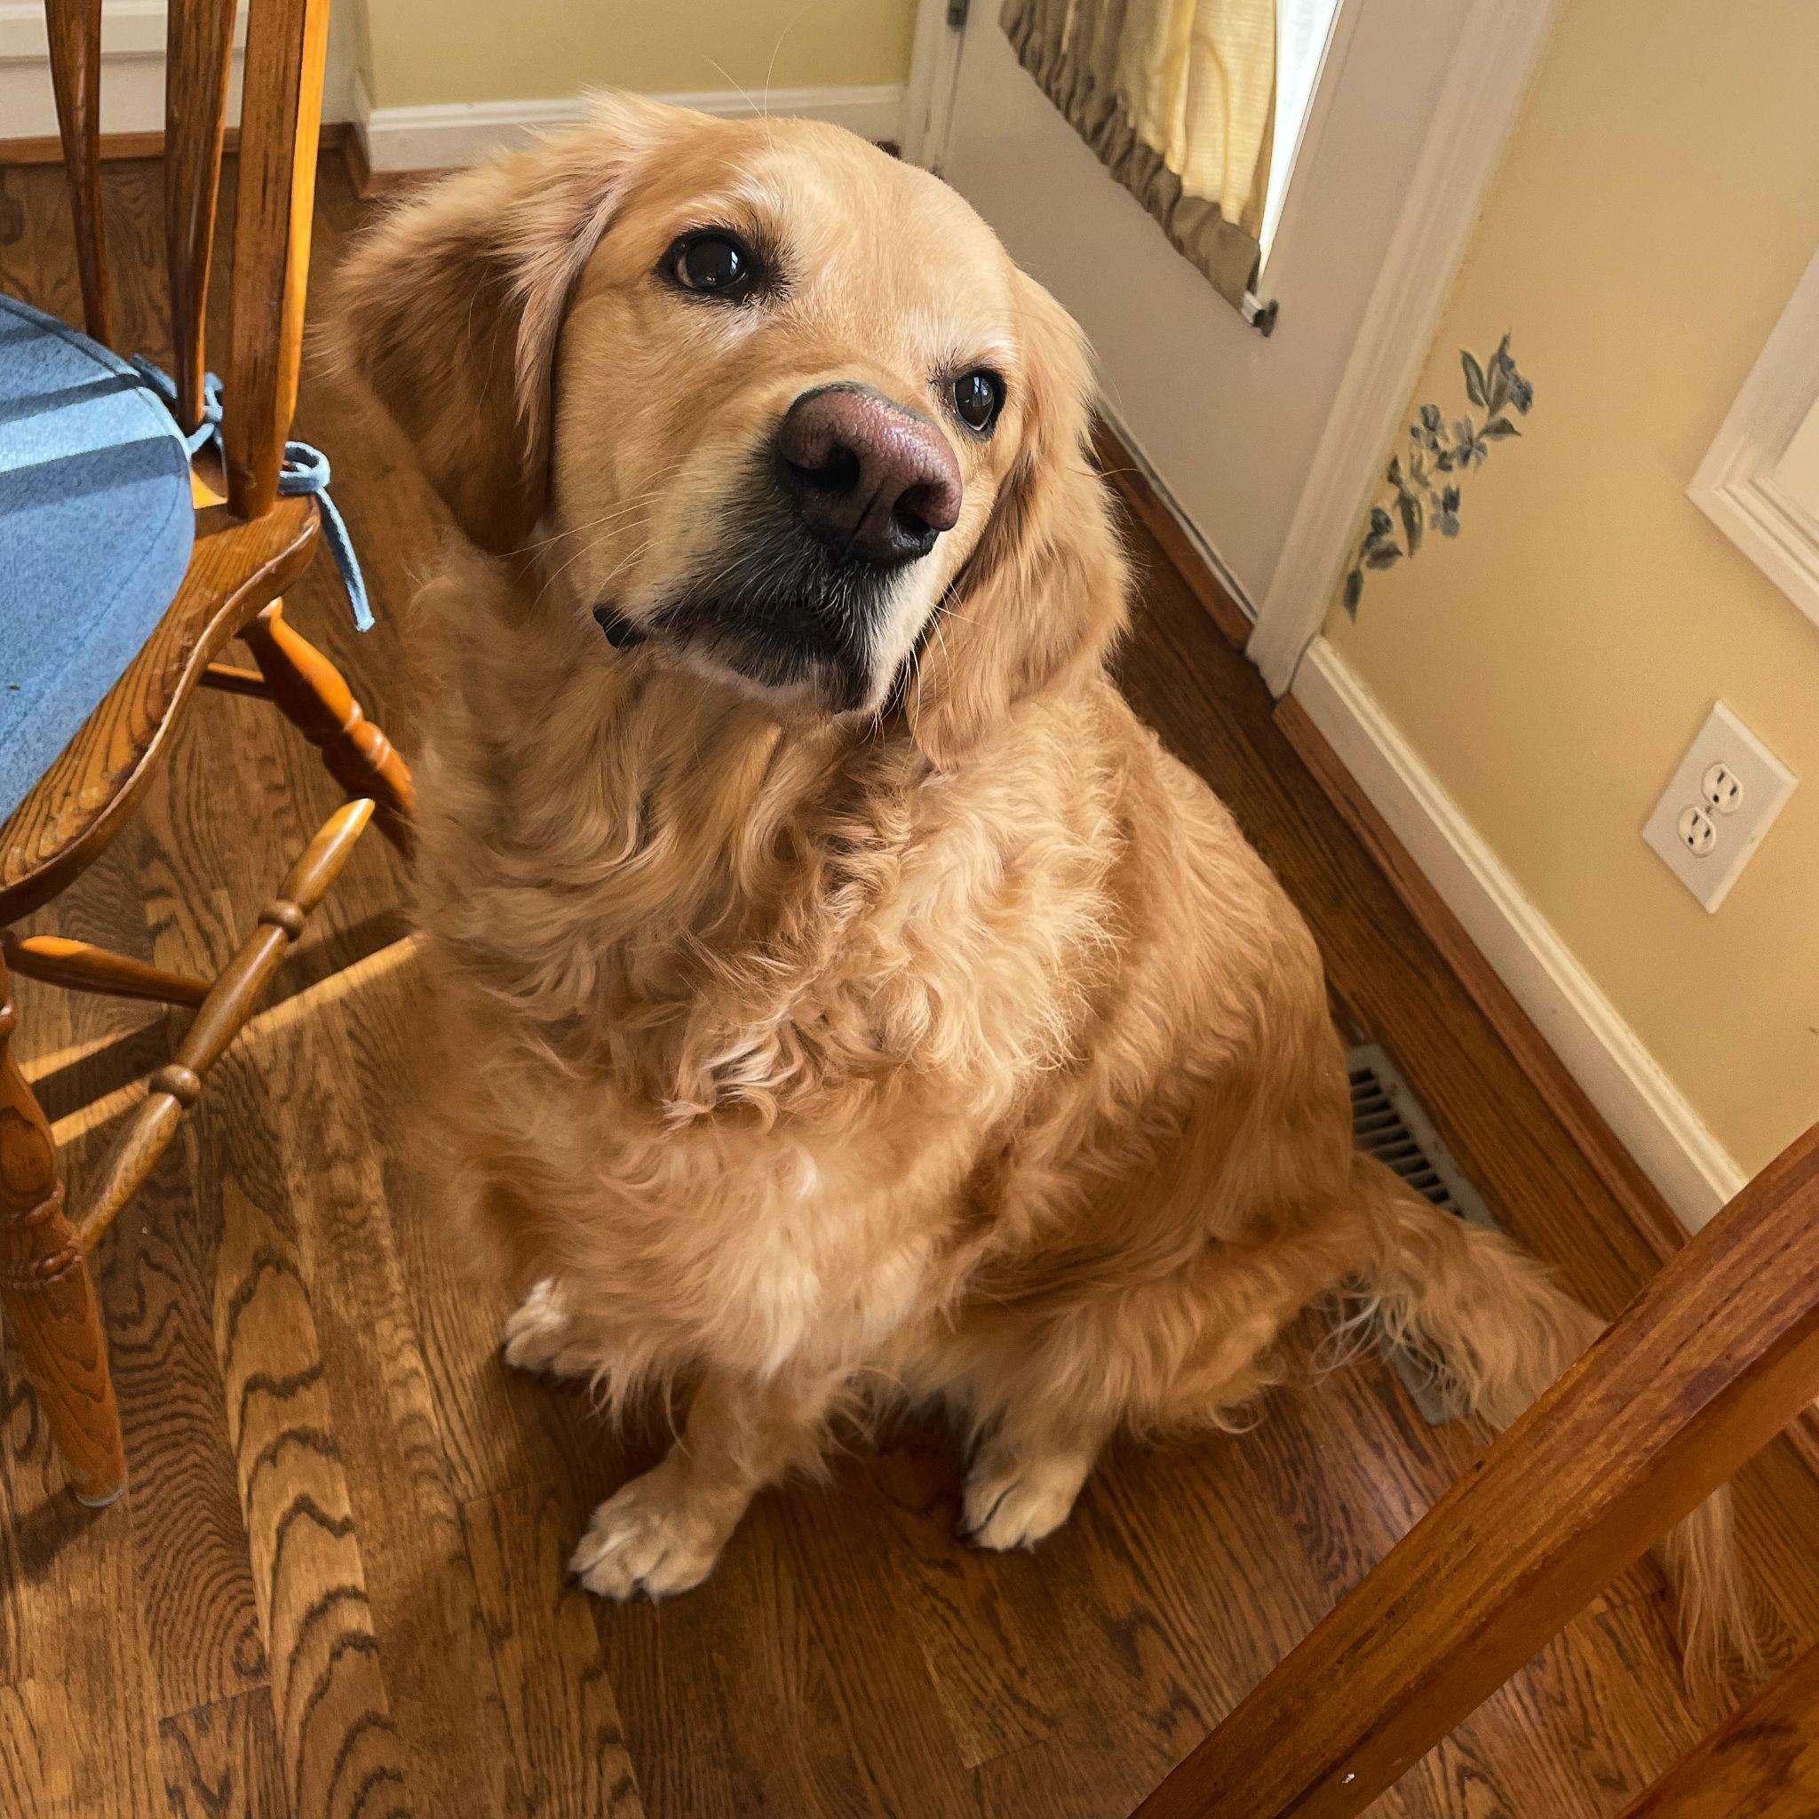
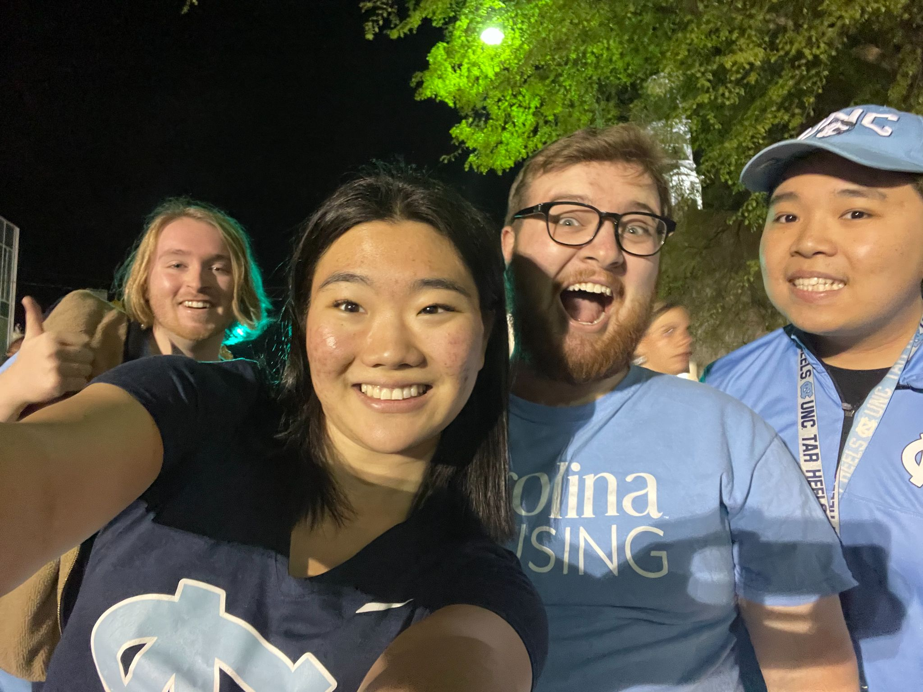
Meet your TA!
Name: Cindy J. Pang
Pronouns: she/her
“Job”: 1st Year PhD student in the Department of Biostatistics at UCLA
I conduct research with Dr. Sudipto Banerjee (Dept. of Biostatistics) as a Graduate Student Researcher (GSR)
Research Interests: Bayesian Statistics for Big Data with applications to wearable device data (actigraph)
Previously:
  Undergraduate @ UNC-Chapel Hill, where I double majored in Mathematics and Biostatistics (Gillings School of Public Health) with a minor in English Literature (American/British Lit)
  I was a Residential Advisor (RA) for 3 years and was an Undergraduate Research Assistant at the Carolina Population Center for 2 years
Hometown: Clifton Park, NY (~ Albany, NY)
Likes: Dogs, Carolina Basketball, Matcha/Tea, Reading, Swimming, Yoga, Taylor Swift, Reading – always open to book suggestions
Dislikes: Socks (I will never wear socks unless I need them), Messy Spaces, DOOK (Duke)

Slide 3
Housekeeping
Office Hours
Lab Grading
Assignment Due Dates

Slide 4
Lab Website
https://cindyjpang.github.io/teaching/biostat100a/ss24-lab1b

Slide 5
TA Office Hours
 | Cindy | Jasen | Danielle
Office Hour Time | Wednesdays 8:00-9:00pm, or by appointment on Zoom ( https://ucla.zoom.us/my/cindyjpang ) | Thursday 2-3pm on Zoom (https://ucla.zoom.us/j/91737617749?pwd=NHt2mPa9aID36lHBeNEqTYDBF8B1bL.1) | Thursdays 10-10:50am (https://ucla.zoom.us/j/91529408052 )
Lab Section Time | [1B] MWF 12:00-12:50p | [1A] MWF 11am-12pm [1C] MWF 1-2pm | [1D] TuTh 1-1:50p [1E] TuTh 11-11:50a
Contact Information | cindypang@g.ucla.edu | jasenzhang@g.ucla.edu | djlavine@g.ucla.edu

Slide 6
Switching Labs
You can attend ANY lab, BUT you must submit your assignments for the DUE DATE for the lab you are ENROLLED in
  i.e. You attend Xiang’s lab section, but you are technically enrolled in Lab G5 or Cindy’s Lab on my.ucla.edu, your lab due dates are on Wednesdays 12:59pm

Slide 7
Lab Grading
5/5 if the Lab is Completed. Mistakes are totally fine, as long as there’s work for all the problems
(1-4)/5 partial completion with 1/5 corresponding to a 20% completion and 4/5 corresponding to a 80% completion
0/5 if there’s like absolutely no work or what you turned in is blank
YOU NEED TO TURN IN ALL THE LABS TO PASS THE COURSE!
I don’t take attendance – Y’all are adults.

Slide 8
Assignment Due Dates
Posted in the Schedule on Website:
If you need an extension, ASK. Life happens. Extensions will be granted by the instructor (Dr. Lee)’s discretion.

